Slide 1
AUGMENTACIJA SLIKA
Na primerima spoljnih scena za primenu u autonomnoj vožnji
https://github.com/matija-speletic/preprocesiranje_seminarski_2

Slide 2
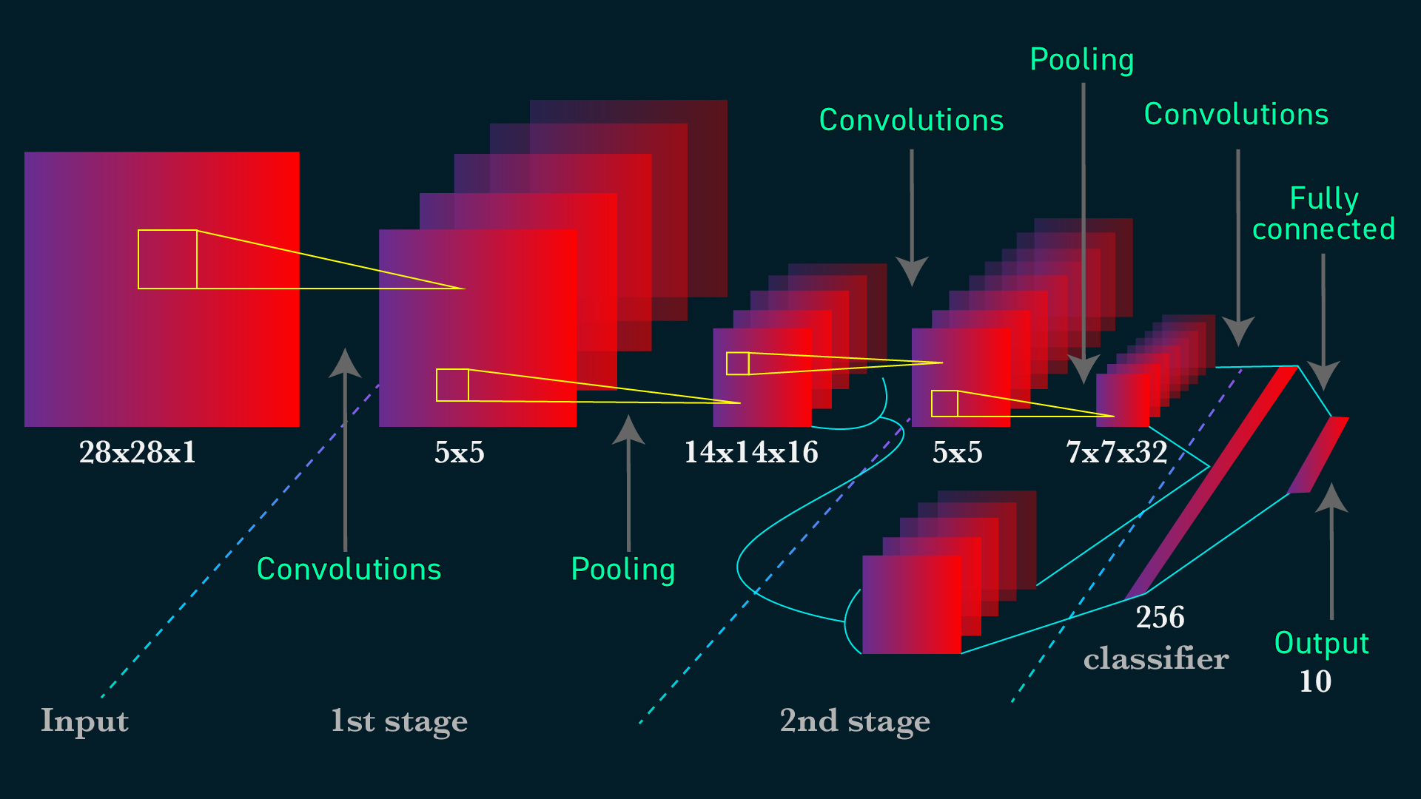
1. Uvod
Razvoj dubokog učenja (deep learning)
CNN zahteva velike skupove podataka za obučavanje
Augmentacija slika za sprečavanje overfitting-a

Slide 3
2. Podela
Augmentacija slika
Osnovne manipulacije
Geometrijske Transformacije
Fotometrijske transformacije
Augmentacija na bazi dubokog učenja
Augmentacija Pomoću GAN modela
Konvolucioni filteri
Nasumično brisanje
Mešanje slika
Neural Style Transfer
Adversarial Training
Generativni modeli
C. Shorten and T. M. Khoshgoftaar, “A survey on image data augmentation for deep learning,” J. Big Data, vol. 6, no. 1, pp. 1–48, 2019.

Slide 4
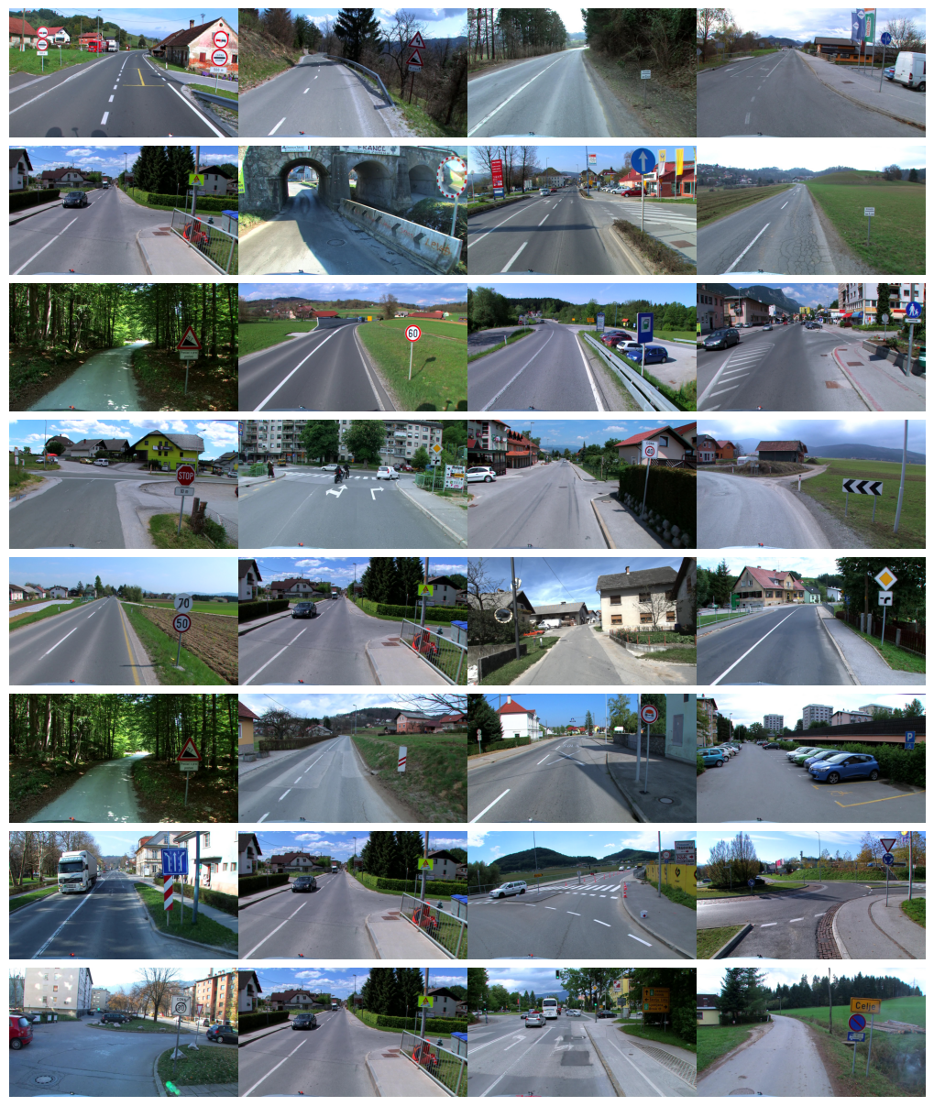
Korišćeni dataset
DFG Traffic Sign Dataset [1]
6758 anotiranih slika
Anotacije saobraćajnih znakova u COCO formatu
Rezolucija 1920×1080
Slovenačka kompanija
U svim primerima je korišćena biblioteka imgaug [2]
[1] Tabernik, Domen, and Danijel Skočaj. "Deep learning for large-scale traffic-sign detection and recognition." IEEE transactions on intelligent transportation systems 21, no. 4 (2019): 1427-1440.
[1] https://github.com/aleju/imgaug

Slide 5
Pomoćne funkcije
Čitanje slika i anotacija
Primena i prikaz augmentacije
images = coco.getImgIds()
image_files = [i['file_name'] for i in coco.loadImgs(images)]
_id_to_file = {i: f for i, f in zip(images, image_files)}
def get_image(_id):
return io.imread(os.path.join(img_dir, _id_to_file[_id]))
def random_image():
_id = np.random.choice(images)
return _id, get_image(_id)
def get_bounding_boxes(_id, img):
anns = coco.getAnnIds(imgIds=_id)
anns = coco.loadAnns(anns)
bbs = [BoundingBox(x['bbox'][0], x['bbox'][1], x['bbox'][0] +
x['bbox'][2], x['bbox'][1] + x['bbox'][3]) for x in anns]
return BoundingBoxesOnImage(bbs, shape=img.shape)
def test_augmentation(aug: iaa.Augmenter, title: str = 'Augmentation', img=None, bbs=None):
if img is None or bbs is None:
_id, img = random_image()
bbs = get_bounding_boxes(_id, img)
img_aug, bbs_aug = aug(image=img, bounding_boxes=bbs)
plt.figure(figsize=(15, 10))
plt.subplot(1, 2, 1)
plt.title('Original')
plt.imshow(bbs.draw_on_image(np.array(img), size=8))
plt.subplot(1, 2, 2)
plt.imshow(bbs_aug.draw_on_image(
np.array(img_aug), size=8))
plt.title(title)
plt.savefig('examples/'+title + '.jpg', dpi=300, bbox_inches='tight')
plt.show()

Slide 6
3.1. Geometrijske transformacije

Slide 7
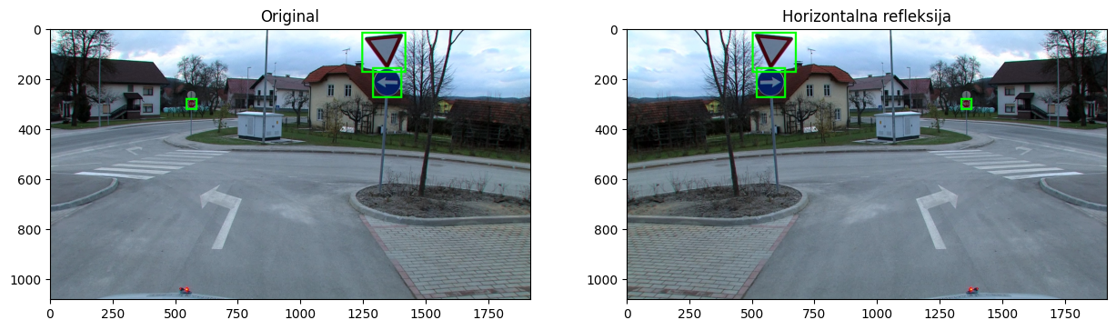
3.1.1. Refleksija
flip = iaa.Fliplr(1.0)
test_augmentation(flip, 'Horizontalna refleksija')

Slide 8
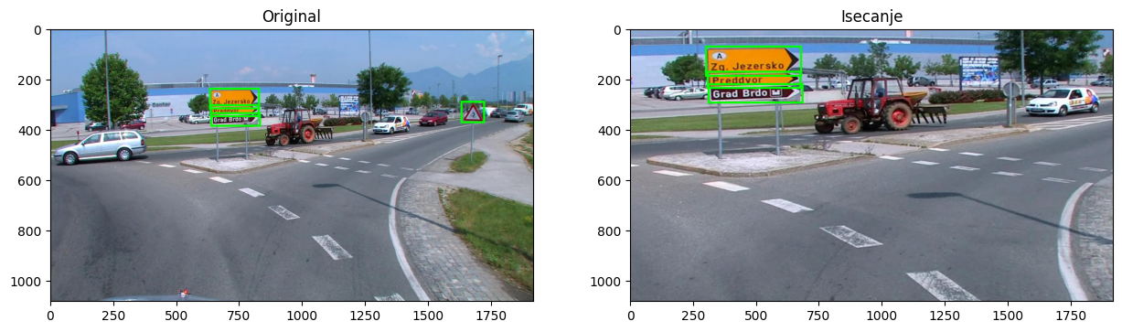
3.1.2. Isecanje (crop)
crop = iaa.Crop(percent=(0.1, 0.3))
test_augmentation(crop, 'Isecanje')

Slide 9
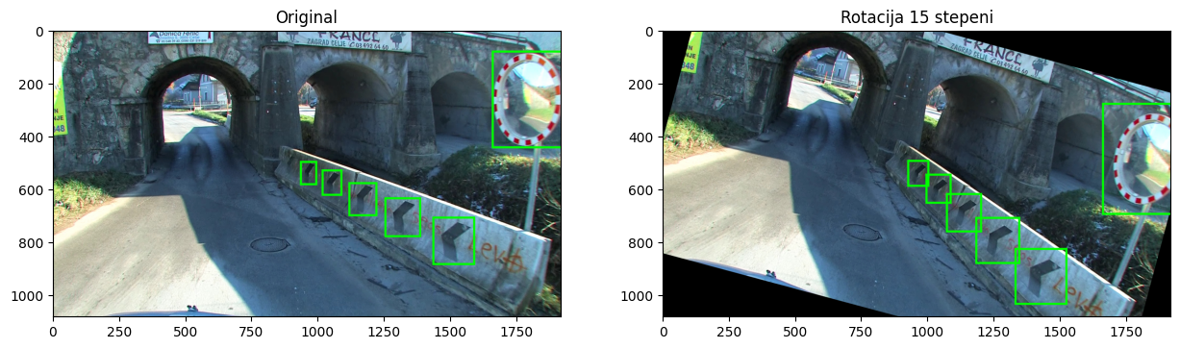
3.1.3. Rotacija
rotate = iaa.Rotate(rotate=15)
test_augmentation(rotate, 'Rotacija 15 stepeni')

Slide 10
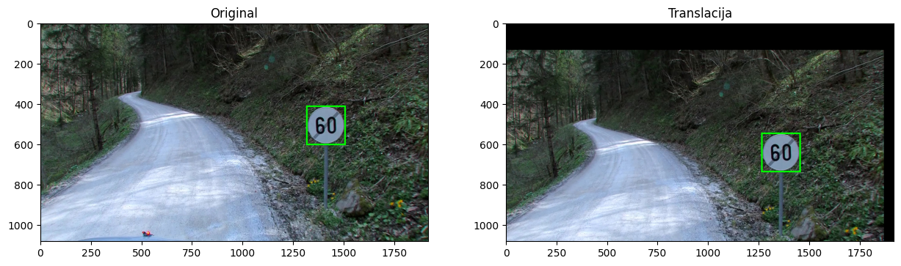
3.1.4. Translacija
translate = iaa.Affine(translate_percent={"x": (-0.2, 0.2), "y": (-0.2, 0.2)})
test_augmentation(translate, 'Translacija')

Slide 11
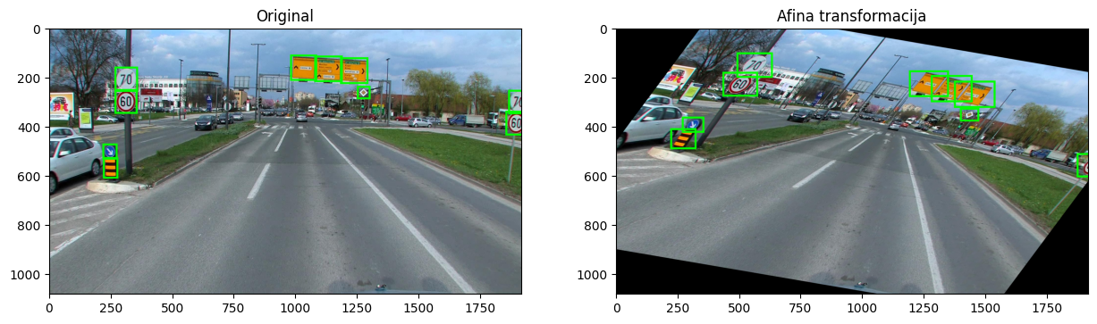
3.1.5. Afina transformacija
affine = iaa.Affine(scale=(0.5, 1.5), rotate=(-15, 15), shear=27)
test_augmentation(affine, 'Afina transformacija')

Slide 12
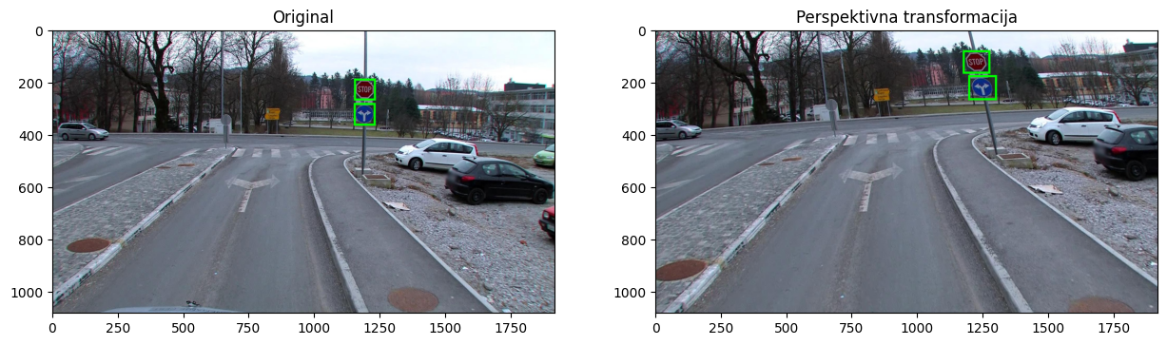
3.1.6. Perspektivna transformacija
perspective = iaa.PerspectiveTransform(scale=0.1)
test_augmentation(perspective, 'Perspektivna transformacija')

Slide 13
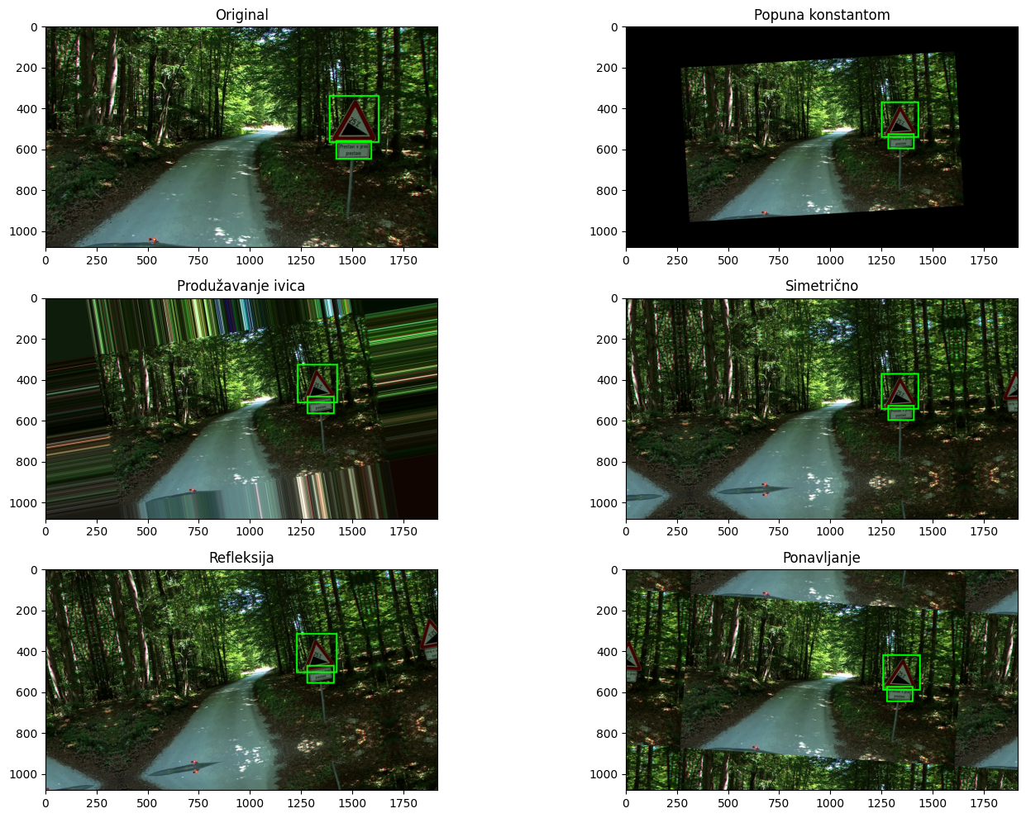
3.1.7. Strategije za popunu
_id, img = random_image()
bbs = get_bounding_boxes(_id, img)
plt.figure(figsize=(15, 10))
plt.subplot(3, 2, 1)
plt.imshow(bbs.draw_on_image(np.array(img), size=8))
plt.title('Original')
modovi = ['Popuna konstantom', 'Produžavanje ivica',
'Simetrično', 'Refleksija', 'Ponavljanje']
for i, mode in enumerate(['constant', 'edge', 'symmetric', 'reflect', 'wrap']):
aug = iaa.Affine(scale=0.7, rotate=(-15, 15), mode=mode)
plt.subplot(3, 2, i+2)
img_aug, bbs_aug = aug(image=img, bounding_boxes=bbs)
plt.imshow(bbs_aug.draw_on_image(np.array(img_aug), size=8))
plt.title(modovi[i])
plt.tight_layout()
plt.savefig('examples/Border_modes.jpg', dpi=300, bbox_inches='tight')
plt.show()

Slide 14
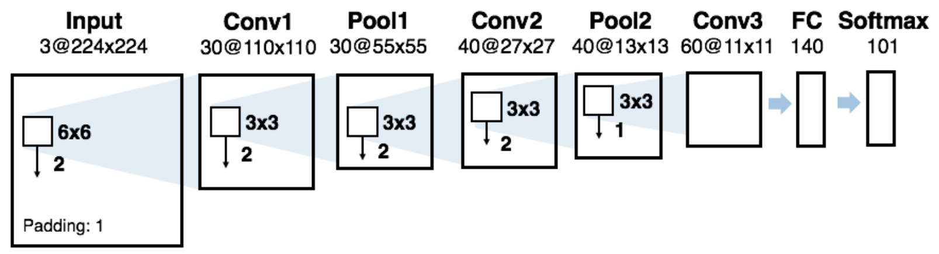
3.1.8. Kako geometrijske transformacije utiču na rezultate modela
Caltech101 skup podataka
 | Top-1 tačnost | Top-5 tačnost
Bez augmentacija | 48.13 ± 0.42% | 64.50 ± 0.65%
Refleksija | 49.73 ± 1.13% | 67.36 ± 1.38%
Rotacija | 50.80 ± 0.63% | 69.41 ± 0.48%
Isecanje | 61.95 ± 1.01% | 79.10 ± 0.80%
L. Taylor and G. Nitschke, “Improving deep learning with generic data augmentation,” in 2018 IEEE symposium series on computational intelligence (SSCI), IEEE, 2018, pp. 1542–1547.

Slide 15
3.2. Transformacije nad prostorom boja (Fotometrijske transformacije)

Slide 16
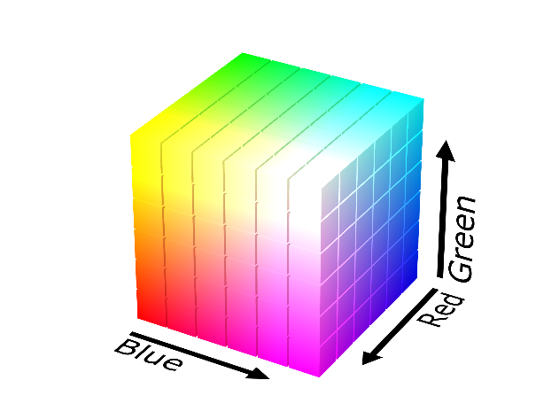
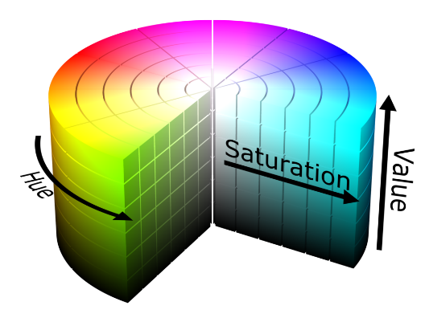
3.2.1. Prostori boja
RGB prostor
Red
Green
Blue
HSL prostor
Hue
Saturation
Lightness

Slide 17
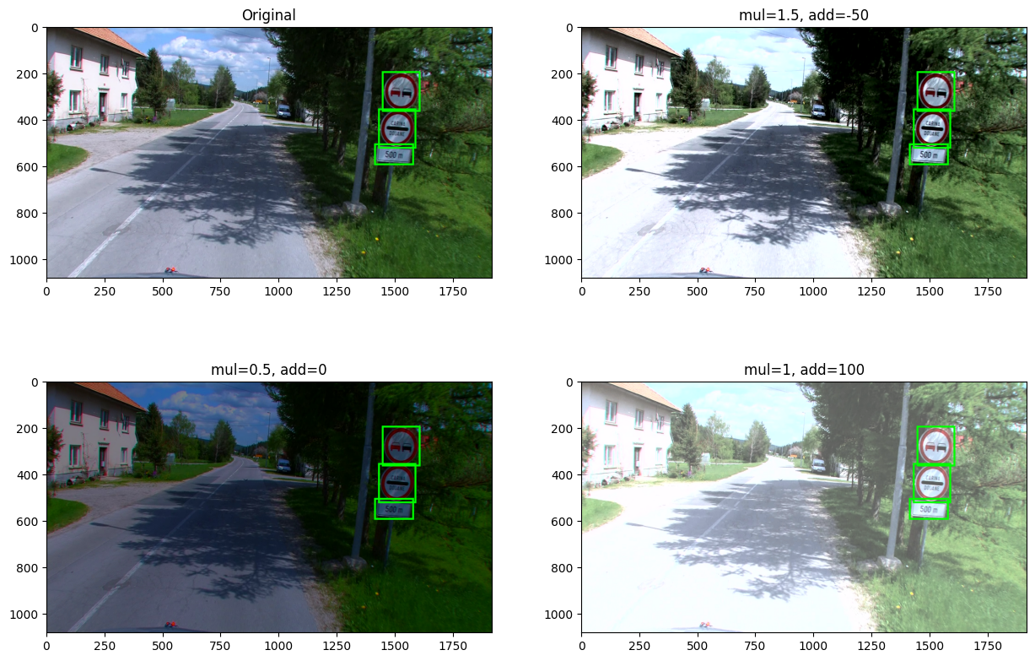
3.2.2. Promena osvetljenja
Aritmetička operacija nad Lightness komponentom
brightness1 = iaa.MultiplyAndAddToBrightness(mul=1.5, add=-10)
brightness2 = iaa.MultiplyAndAddToBrightness(mul=0.5, add=0)
brightness3 = iaa.MultiplyAndAddToBrightness(mul=1, add=100)
_id, img = random_image()
bbs = get_bounding_boxes(_id, img)
plt.figure(figsize=(15, 10))
plt.subplot(2, 2, 1)
plt.title('Original')
plt.imshow(bbs.draw_on_image(np.array(img), size=8))
for i, (aug, title) in enumerate(
zip([brightness1, brightness2, brightness3],
['mul=1.5, add=-50', 'mul=0.5, add=0', 'mul=1, add=100'])):
img_aug, bbs_aug = aug(image=img, bounding_boxes=bbs)
plt.subplot(2, 2, i+2)
plt.imshow(bbs_aug.draw_on_image(
np.array(img_aug), size=8))
plt.title(title)
plt.savefig('examples/'+'brightness' + '.jpg', dpi=300, bbox_inches='tight')
plt.show()

Slide 18
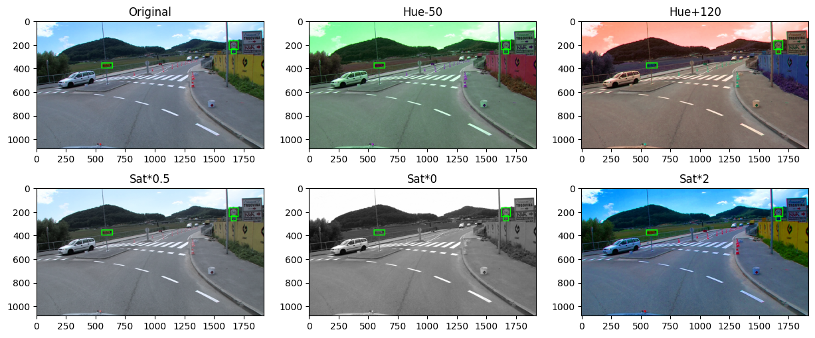
3.2.3. Promena nijanse i zasićenosti
aug1 = iaa.AddToHue(-50)
aug2 = iaa.AddToHue(120)
aug3 = iaa.MultiplySaturation(0.5)
aug4 = iaa.MultiplySaturation(0)
aug5 = iaa.MultiplySaturation(2)
_id, img = random_image()
bbs = get_bounding_boxes(_id, img)
plt.figure(figsize=(15, 6))
plt.subplot(2, 3, 1)
plt.title('Original')
plt.imshow(bbs.draw_on_image(np.array(img), size=8))
for i, (aug, title) in enumerate(
zip([aug1, aug2, aug3, aug4, aug5],
['Hue-50', 'Hue+120', 'Sat*0.5', 'Sat*0', 'Sat*2'])):
img_aug, bbs_aug = aug(image=img, bounding_boxes=bbs)
plt.subplot(2, 3, i+2)
plt.imshow(bbs_aug.draw_on_image(
np.array(img_aug), size=8))
plt.title(title)
plt.savefig('examples/'+'huesat' + '.jpg', dpi=300, bbox_inches='tight')
plt.show()

Slide 19
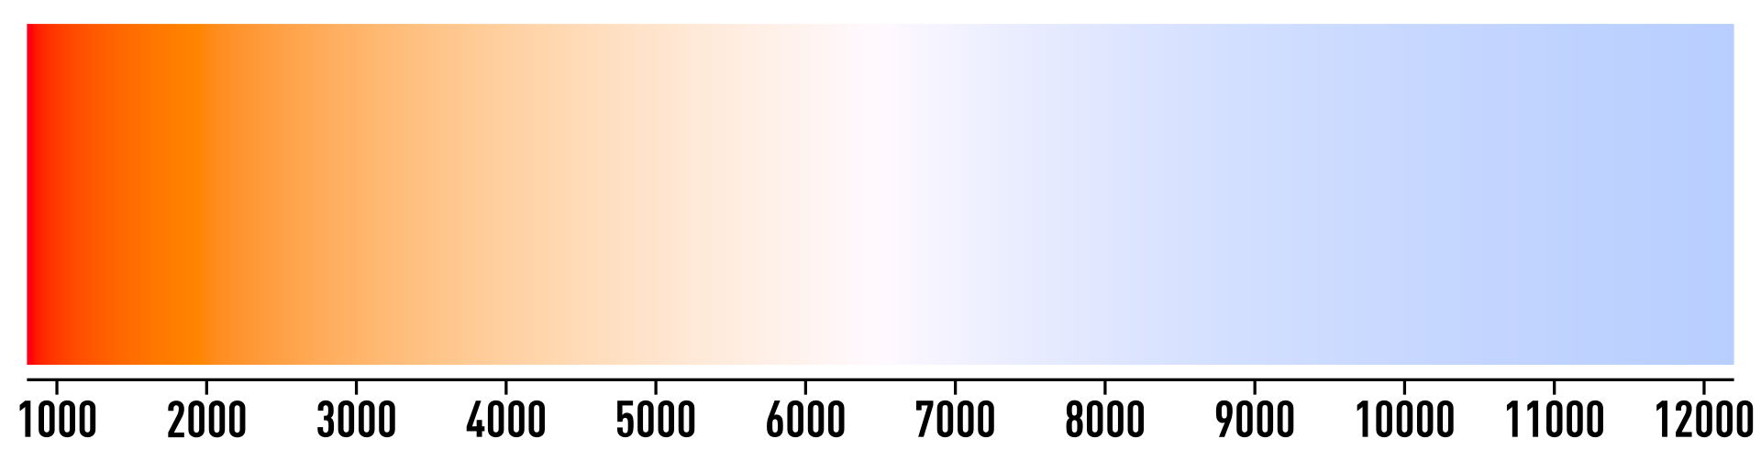
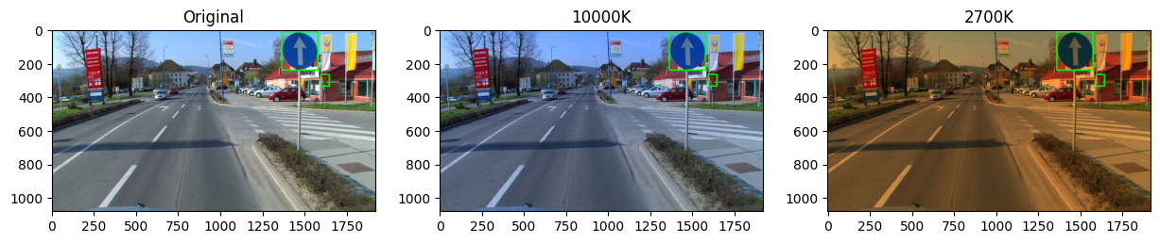
3.2.4. Promena temperature
aug1 = iaa.ChangeColorTemperature(10000)
aug2 = iaa.ChangeColorTemperature(2700)
_id, img = random_image()
bbs = get_bounding_boxes(_id, img)
plt.figure(figsize=(15, 5))
plt.subplot(1, 3, 1)
plt.title('Original')
plt.imshow(bbs.draw_on_image(np.array(img), size=8))
for i, (aug, title) in enumerate(
zip([aug1, aug2],
['10000K', '2700K'])):
img_aug, bbs_aug = aug(image=img, bounding_boxes=bbs)
plt.subplot(1, 3, i+2)
plt.imshow(bbs_aug.draw_on_image(
np.array(img_aug), size=8))
plt.title(title)
plt.savefig('examples/'+'temp' + '.jpg', dpi=300, bbox_inches='tight')
plt.show()
Simulira različita doba dana ili godine

Slide 20
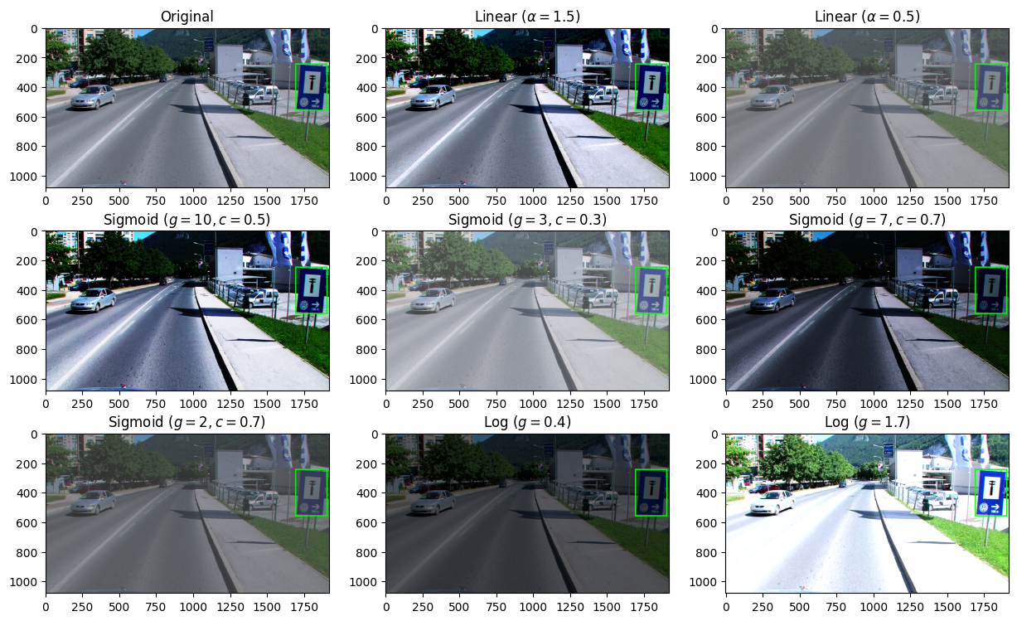



3.2.5. Promena kontrasti
aug1 = iaa.LinearContrast(1.5)
aug2 = iaa.LinearContrast(0.5)
aug3 = iaa.SigmoidContrast(gain=10, cutoff=0.5)
aug4 = iaa.SigmoidContrast(gain=3, cutoff=0.3)
aug5 = iaa.SigmoidContrast(gain=7, cutoff=0.7)
aug6 = iaa.SigmoidContrast(gain=2, cutoff=0.7)
aug7 = iaa.LogContrast(gain=0.4)
aug8 = iaa.LogContrast(gain=1.7)
$$v^{′}=127+α\left(v−127\right)$$
$$v^{′}=\frac{255}{1+e^{g\left(c−\frac{v}{255}\right)}}$$
Nivo razlike u bojama objekata u pozadine
Ljudski vid je osetljiv na promene u kontrasti
Linearna
Sigmnoidna
Logaritamska
…
$$v^{′}=255g⋅log_{2}\left(1+\frac{v}{255}\right)$$

Slide 21

3.3. Transformacija konvolucijom

Slide 22
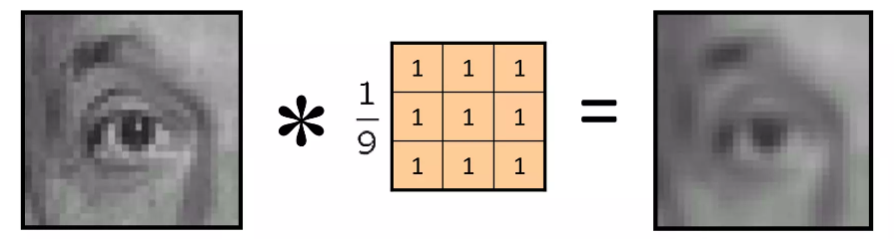
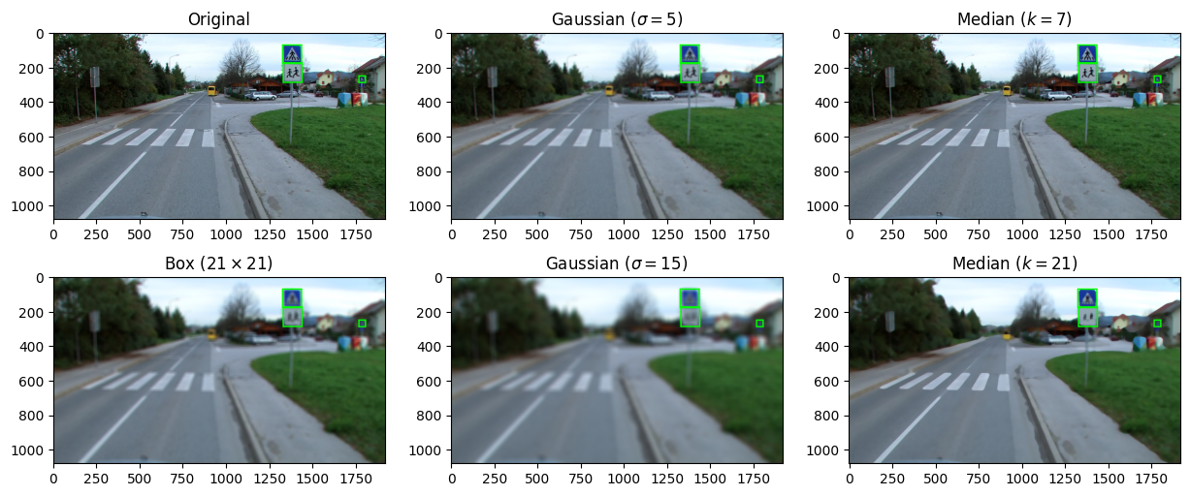
3.3.1. Zamućenje slika
Box zamućenje
Gausovo zamućenje
Zamućenje medijane
aug1 = iaa.GaussianBlur(sigma=5)
aug2 = iaa.MedianBlur(k=7)
aug3 = iaa.Convolve(matrix=np.ones((21, 21))/(21*21))
aug4 = iaa.GaussianBlur(sigma=15)
aug5 = iaa.MedianBlur(k=21)

Slide 23
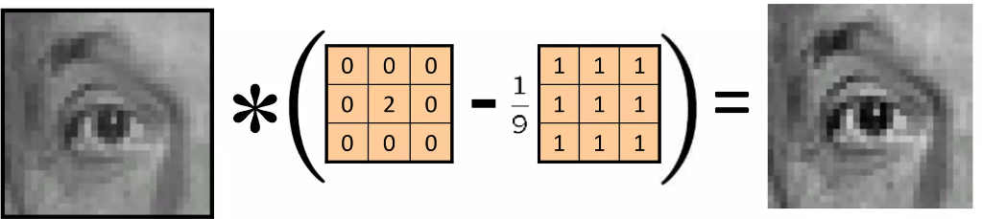
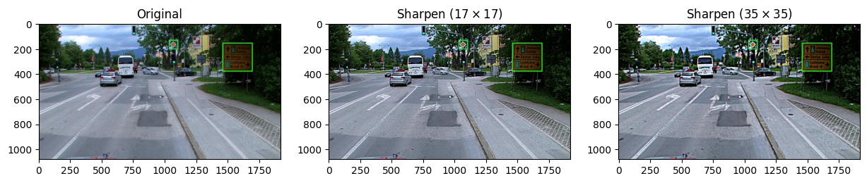
3.3.2. Izoštravanje slike
Obrnuta operacija od zamućenja
Od slika „oduzimamo“ zamućenje
sharpen_kernel_35 = np.zeros((35, 35))
sharpen_kernel_35[17, 17] = 2
sharpen_kernel_35 -= 1/(35*35)
sharpen_kernel_17 = np.zeros((17, 17))
sharpen_kernel_17[8, 8] = 2
sharpen_kernel_17 -= 1/289
aug1 = iaa.Convolve(matrix=sharpen_kernel_17)
aug2 = iaa.Convolve(matrix=sharpen_kernel_35)

Slide 24
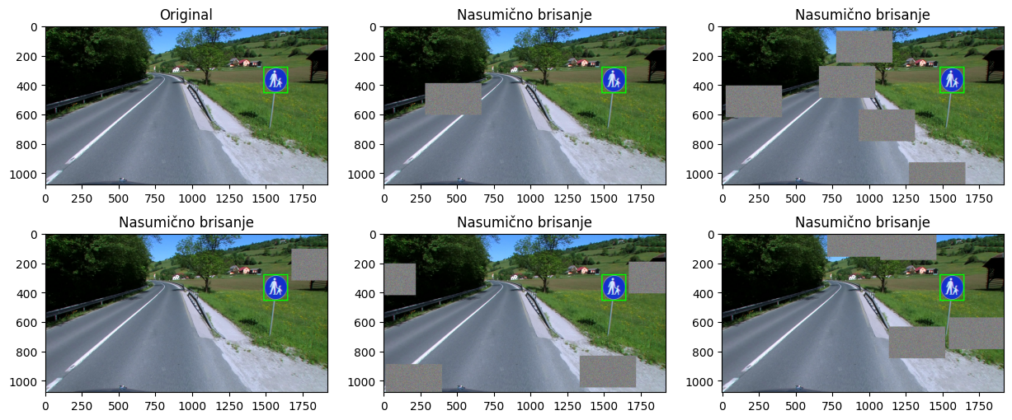
3.4. Brisanje delova slike (Random Erasing)
Slično kao dropout regularizacija
Sprečava overfitting modela za specifične karakteristike
Simulira okluziju (skrivanje delova)
cutout = iaa.Cutout(nb_iterations=(1, 5), size=0.2,
squared=False, fill_mode='gaussian’,
fill_per_channel=True)
Z. Zhong, L. Zheng, G. Kang, S. Li, and Y. Yang, “Random erasing data augmentation,” in Proceedings of the AAAI conference on artificial intelligence, 2020, pp. 13001–13008.

Slide 25
3.4. Brisanje delova slike - rezultati
Model | C10 | C10+ | C100 | C100+ | SVHN
ResNet18 | 10.63 ± 0.26 | 4.72 ± 0.21 | 36.68 ± 0.57 | 22.46 ± 0.31 | -
ResNet18+RE | 9.31 ± 0.18 | 3.99 ± 0.13 | 34.98 ± 0.29 | 21.96 ± 0.24 | -
WideResNet | 6.97 ± 0.22 | 3.87 ± 0.08 | 26.06 ± 0.22 | 18.8 ± 0.08 | 1.60 ± 0.05
WideResNet+RE | 5.54 ± 0.08 | 3.08 ± 0.16 | 23.94 ± 0.15 | 18.41 ± 0.27 | 1.30 ± 0.03
Shake-Shake | - | 2.86 | - | 15.85 | -
Shake-Shake+RE | - | 2.56 ± 0.07 | - | 15.20 ± 0.21 | -
T. DeVries and G. W. Taylor, “Improved regularization of convolutional neural networks with cutout,” ArXiv Prepr. ArXiv170804552, 2017.
Model | STL10 | STL10+
WideResNet | 23.48 ± 0.68 | 14.21 ± 0.29
WideResNet+RE | 20.77 ± 0.38 | 12.74 ± 0.23
T. DeVries and G. W. Taylor, “Improved regularization of convolutional neural networks with cutout,” ArXiv Prepr. ArXiv170804552, 2017.
Model | Bez RE | RE
ResNet34 | 8.01 | 7.71
ResNet50 | 6.89 | 6.69
ResNet101 | 5.73 | 5.30
Z. Zhong, L. Zheng, G. Kang, S. Li, and Y. Yang, “Random erasing data augmentation,” in Proceedings of the AAAI conference on artificial intelligence, 2020, pp. 13001–13008.
Z. Zhong, L. Zheng, G. Kang, S. Li, and Y. Yang, “Random erasing data augmentation,” in Proceedings of the AAAI conference on artificial intelligence, 2020, pp. 13001–13008.
Popuna | Bez brisanja | Nasumična | Srednja vrednost | Crna (0) | Bela (255)
Greška | 5.17 ± 0.18 | 4.31 ± 0.07 | 4.35 ± 0.12 | 4.62 ± 0.09 | 4.85 ± 0.13

Slide 26
3.5. Narušavanje kvaliteta slike

Slide 27
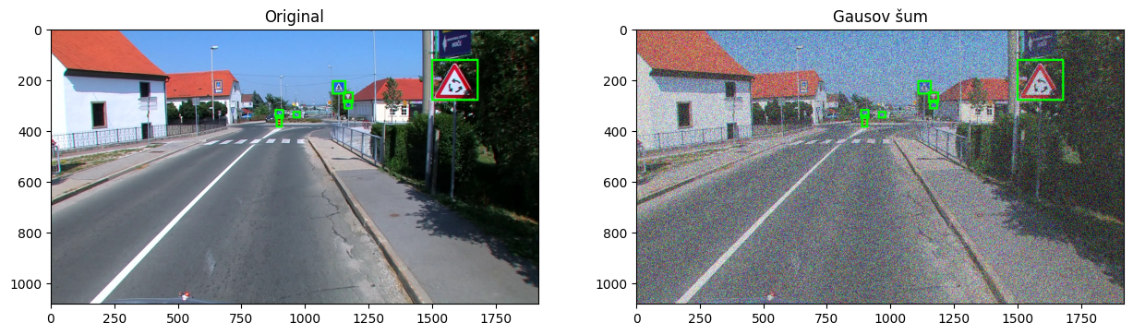
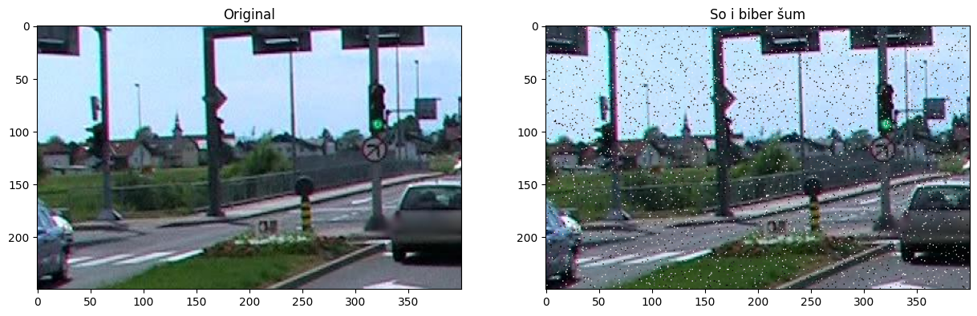
3.5.1. Dodavanje šuma
Gusov šum
Salt-and-Pepper šum
aug1 = iaa.AdditiveGaussianNoise(scale=0.5*255, per_channel=True)
salt_pepper = iaa.SaltAndPepper(0.05)

Slide 28
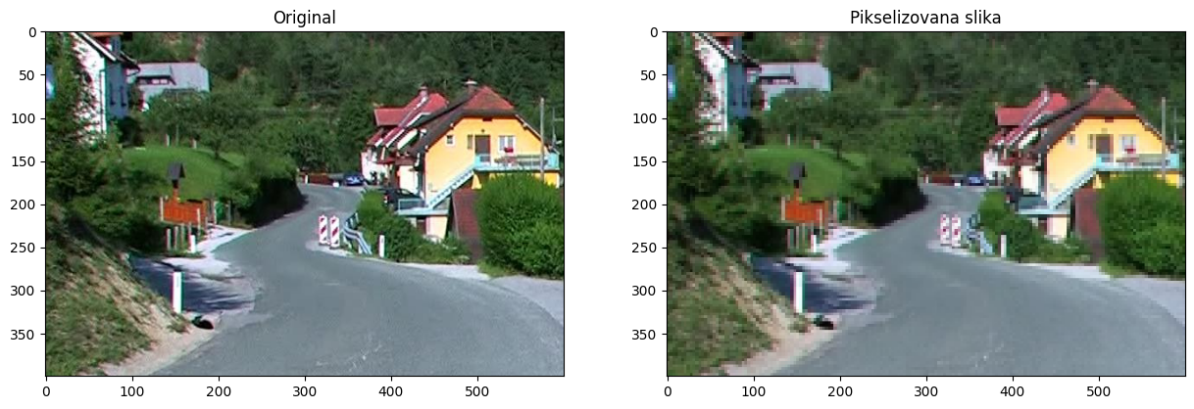
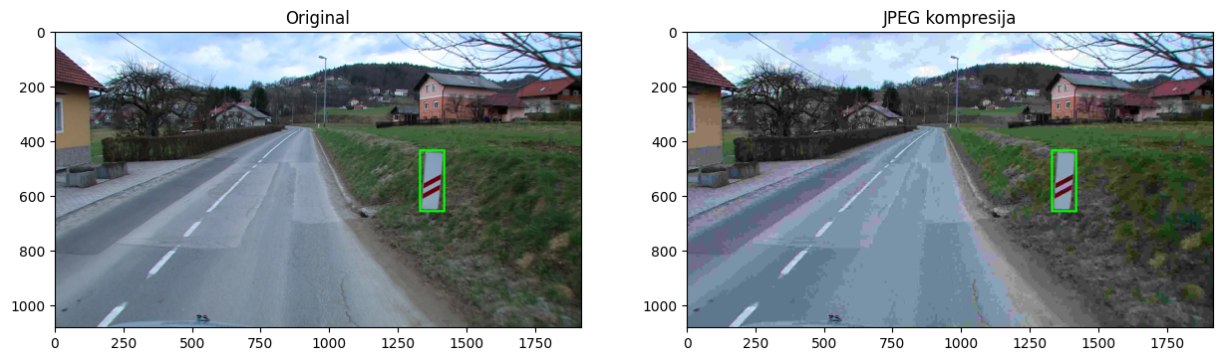
3.5.2. Pikselizacija
3.5.3. Kompresija (JPEG)
pixelate = iaa.imgcorruptlike.Pixelate(severity=4)
jpeg = iaa.imgcorruptlike.JpegCompression(severity=5)

Slide 29
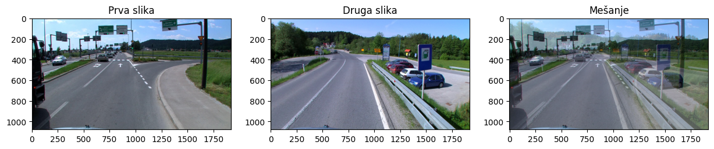
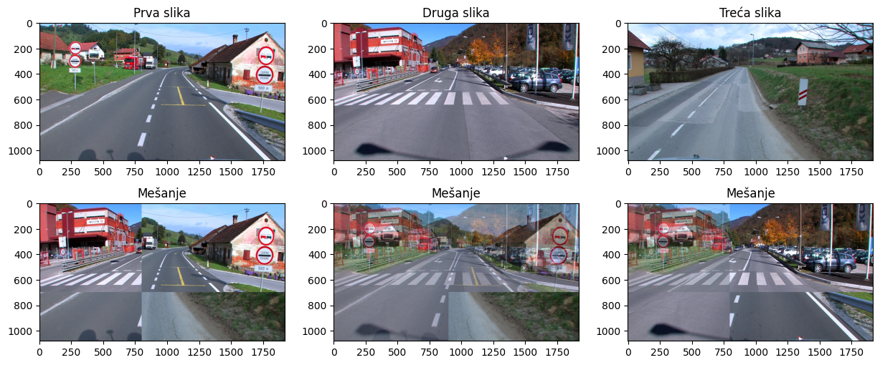
3.6. Mešanje slika
img_blend = (img1*alpha+img2*(1-alpha))/255.0
Pristup nije intuitivan
Može smanjiti grešku (sa 8.22% na 6.93%) [1]
Srednja vrednost slika
Nelinearno mešanje [2]
[1] H. Inoue, “Data augmentation by pairing samples for images classification,” ArXiv Prepr. ArXiv180102929, 2018.
[2] C. Summers and M. J. Dinneen, “Improved mixed-example data augmentation,” in 2019 IEEE winter conference on applications of computer vision (WACV), IEEE, 2019, pp. 1262–1270.

Slide 30
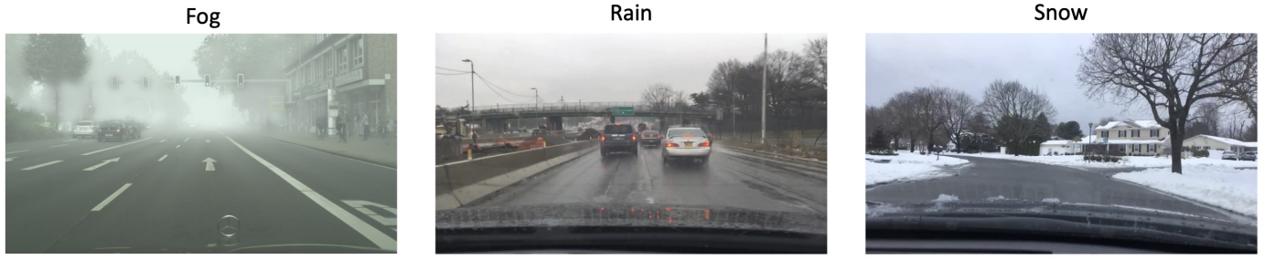
3.7. Simulacija vremenskih uslova

Slide 31
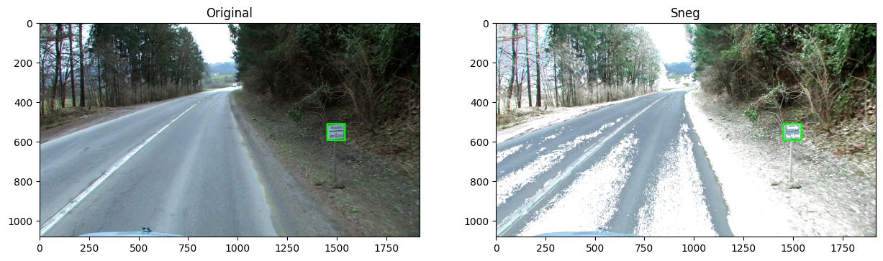
3.7.1. Simulacija snežnog pokrivača
Kombinacija fotometrijskih transformacija
snow = iaa.FastSnowyLandscape(
lightness_multiplier=2.5, lightness_threshold=150)
test_augmentation(snow, 'Sneg')

Slide 32
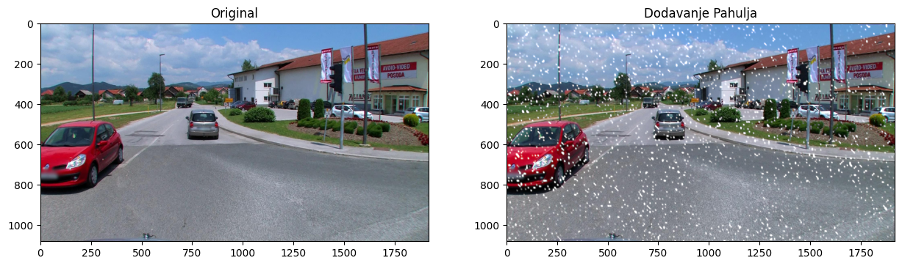
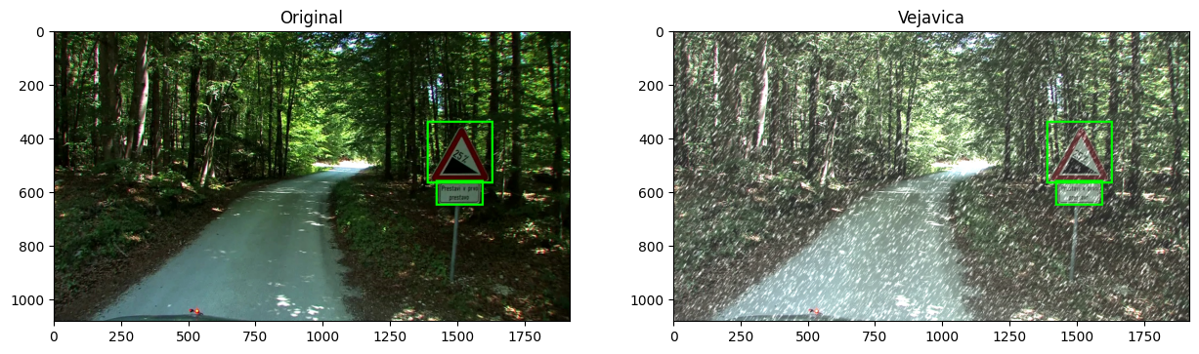
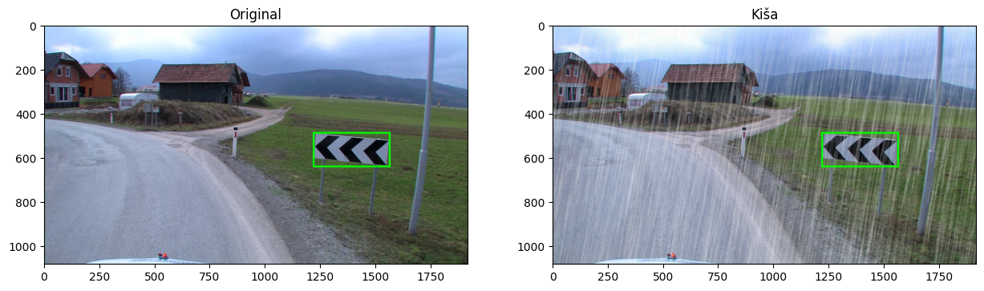
3.7.2. Simulacija padavina
snowflakes = iaa.Snowflakes(
flake_size=(0.7, 0.95),
speed=(0.001, 0.01))
snow = iaa.imgcorruptlike.Snow(severity=3)
rain = iaa.Rain(
speed=(0.1, 0.3),
drop_size=(0.7, 1.0))

Slide 33
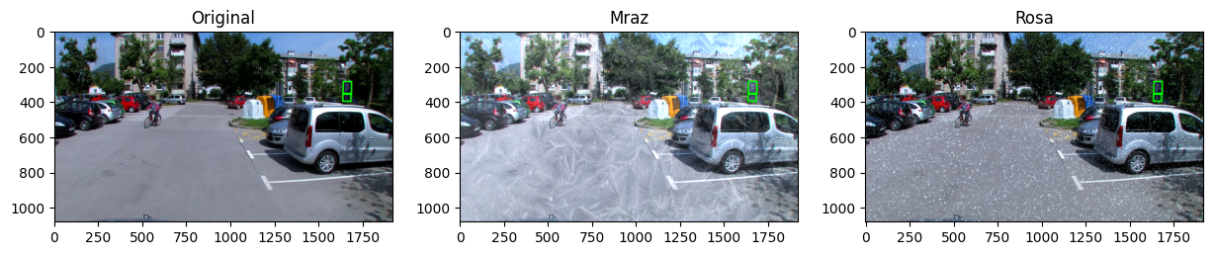
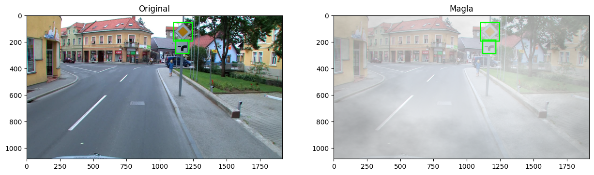
3.7.3. Simulacija mraza, rose i magle
aug1 = iaa.imgcorruptlike.Frost(severity=1)
aug2 = iaa.imgcorruptlike.Spatter(severity=3)
fog = iaa.Fog()

Slide 34
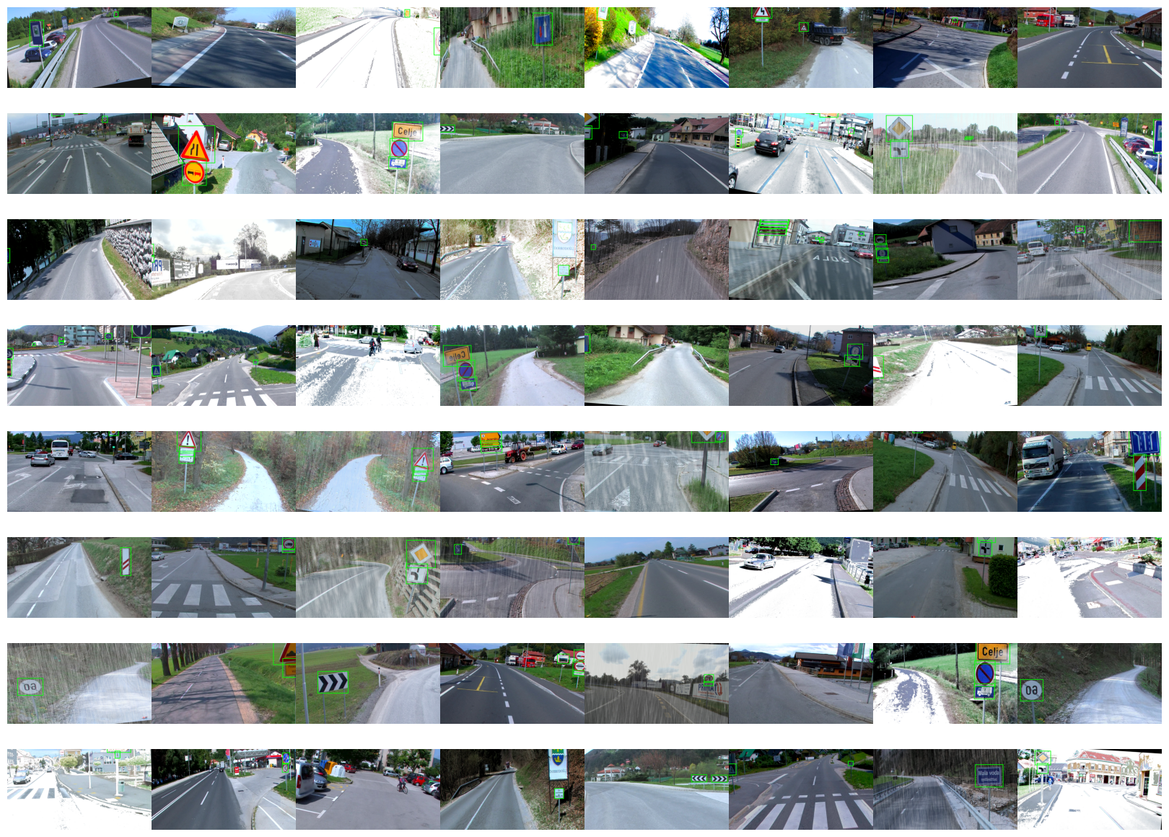
Kombinovanje transformacija
aug_pipeline = iaa.Sequential([
iaa.Fliplr(0.5),
iaa.Affine(rotate=(-10, 10)),
iaa.Crop(percent=(0, 0.3)),
iaa.MultiplyAndAddToBrightness(mul=(0.8, 1.2), add=(-30, 30)),
iaa.Sometimes(0.2, iaa.Rain(speed=(0.1, 0.3), drop_size=(0.7, 1.0))),
iaa.Sometimes(0.2, iaa.FastSnowyLandscape(
lightness_multiplier=2.5, lightness_threshold=150))
])

Slide 35
4. Tehnike na bazi dubokog učenja

Slide 36
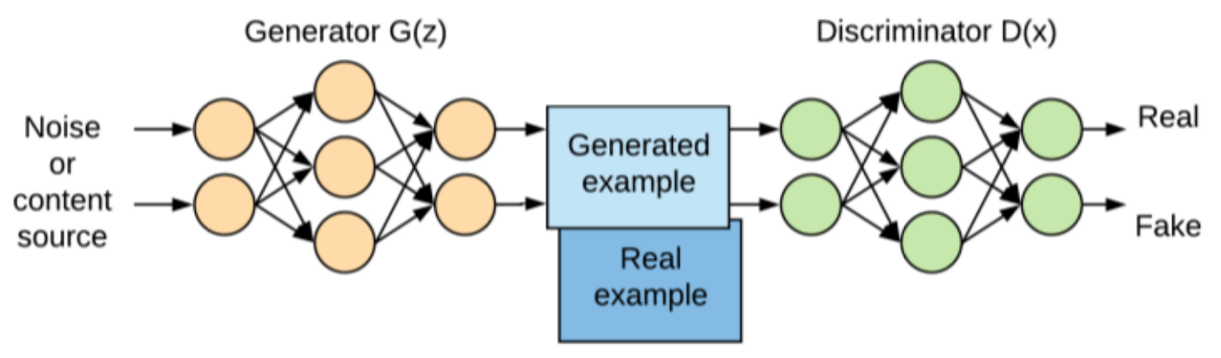
4.1. GAN modeli
Generative Adversarial Networks [1]
Sastoje se od:
Generatora – generiše slike tako da zavara diskriminatora
Diskriminatora – pokušava da prepozna slike koje je napravio generator
A. Mikołajczyk and M. Grochowski, “Data augmentation for improving deep learning in image classification problem,” in 2018 international interdisciplinary PhD workshop (IIPhDW), IEEE, 2018, pp. 117–122.
[1] I. Goodfellow et al., “Generative adversarial nets,” Adv. Neural Inf. Process. Syst., vol. 27, 2014.

Slide 37
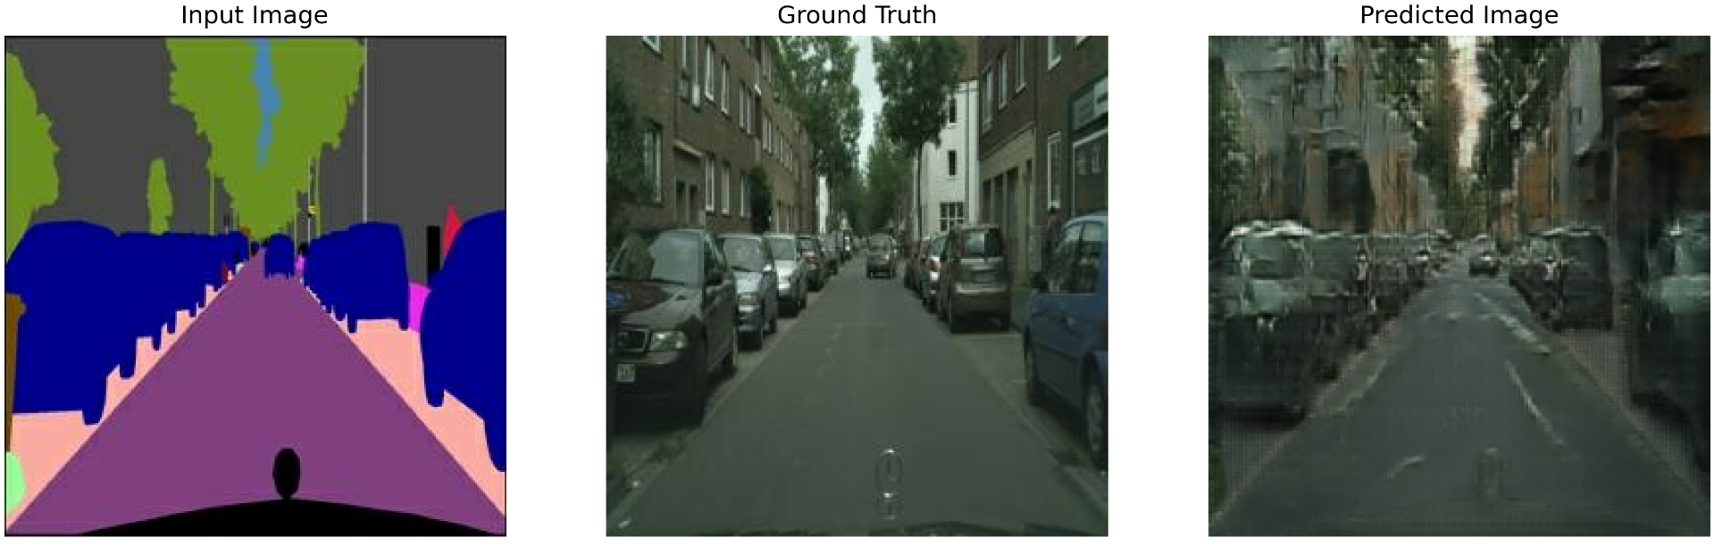
4.1.1. pix2pix
Image-to-image translacija, koristi cGAN arhitekturu [1]
Na osnovu segmentacione mape generiše sliku
Cityscapes dataset [2] (jedna od primena)
[1] P. Isola, J.-Y. Zhu, T. Zhou, and A. A. Efros, “Image-to-Image Translation with Conditional Adversarial Networks.” 2018.
[2] M. Cordts et al., “The cityscapes dataset,” in CVPR Workshop on the Future of Datasets in Vision, 2015, p. 1.

Slide 38
pix2pix - Generator
def downsample(filters, size, apply_batchnorm=True):
initializer = tf.random_normal_initializer(0., 0.02)
result = tf.keras.Sequential()
result.add(
tf.keras.layers.Conv2D(filters, size, strides=2, padding='same',
kernel_initializer=initializer, use_bias=False))
if apply_batchnorm:
result.add(tf.keras.layers.BatchNormalization())
result.add(tf.keras.layers.LeakyReLU())
return result
Zasniva se na U-Net arhitekturi [1]
Sastoji se od:
Upsample
Downsample blokova
def upsample(filters, size, apply_dropout=False):
initializer = tf.random_normal_initializer(0., 0.02)
result = tf.keras.Sequential()
result.add(
tf.keras.layers.Conv2DTranspose(filters, size, strides=2,
padding='same',
kernel_initializer=initializer,
use_bias=False))
result.add(tf.keras.layers.BatchNormalization())
if apply_dropout:
result.add(tf.keras.layers.Dropout(0.5))
result.add(tf.keras.layers.ReLU())
return result
[1] O. Ronneberger, P. Fischer, and T. Brox, “U-Net: Convolutional Networks for Biomedical Image Segmentation.” 2015.

Slide 39
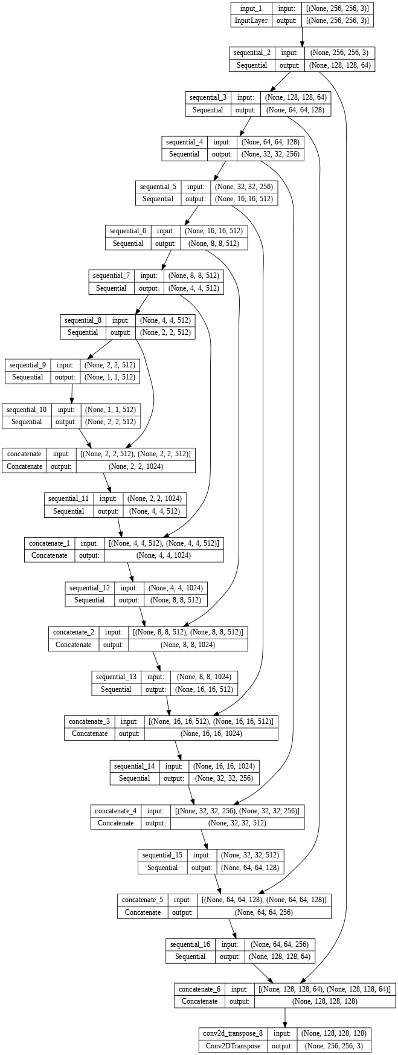
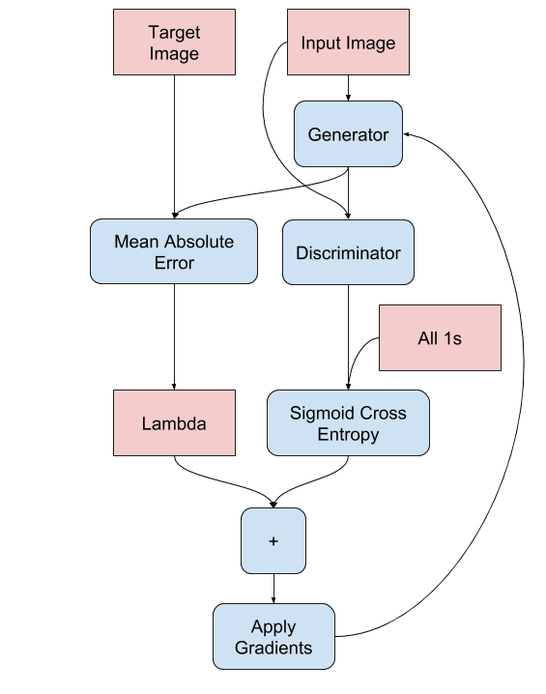
pix2pix – Generator
def Generator():
inputs = tf.keras.layers.Input(shape=[256, 256, 3])
down_stack = [
downsample(64, 4, apply_batchnorm=False), # (batch_size, 128, 128, 64)
downsample(128, 4), # (batch_size, 64, 64, 128)
downsample(256, 4), # (batch_size, 32, 32, 256)
downsample(512, 4), # (batch_size, 16, 16, 512)
downsample(512, 4), # (batch_size, 8, 8, 512)
downsample(512, 4), # (batch_size, 4, 4, 512)
downsample(512, 4), # (batch_size, 2, 2, 512)
downsample(512, 4), # (batch_size, 1, 1, 512)
]
up_stack = [
upsample(512, 4, apply_dropout=True), # (batch_size, 2, 2, 1024)
upsample(512, 4, apply_dropout=True), # (batch_size, 4, 4, 1024)
upsample(512, 4, apply_dropout=True), # (batch_size, 8, 8, 1024)
upsample(512, 4), # (batch_size, 16, 16, 1024)
upsample(256, 4), # (batch_size, 32, 32, 512)
upsample(128, 4), # (batch_size, 64, 64, 256)
upsample(64, 4), # (batch_size, 128, 128, 128)
]
initializer = tf.random_normal_initializer(0., 0.02)
last = tf.keras.layers.Conv2DTranspose(OUTPUT_CHANNELS, 4,
strides=2,
padding='same',
kernel_initializer=initializer,
activation='tanh')
x = inputs
skips = []
for down in down_stack:
x = down(x)
skips.append(x)
skips = reversed(skips[:-1])
for up, skip in zip(up_stack, skips):
x = up(x)
x = tf.keras.layers.Concatenate()([x, skip])
x = last(x)
return tf.keras.Model(inputs=inputs, outputs=x)

Slide 40
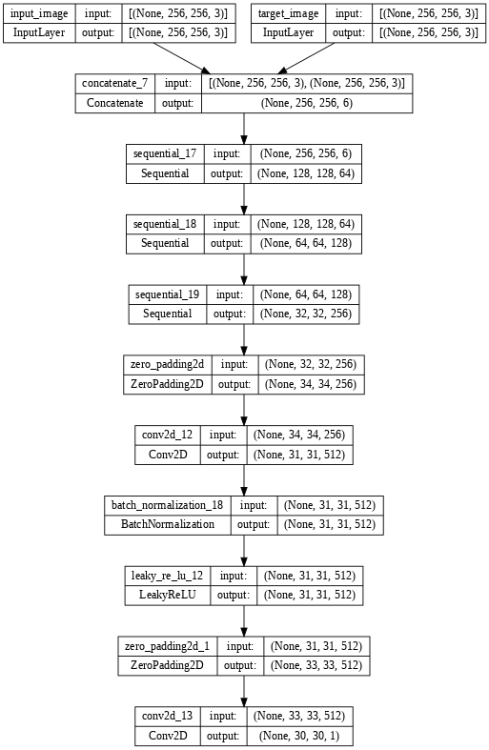
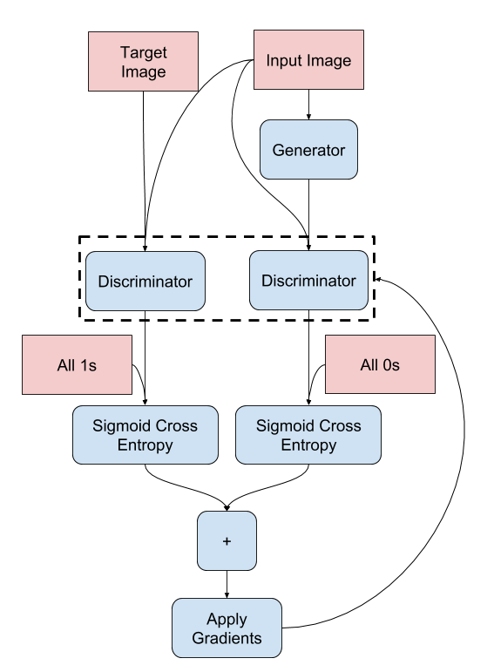
pix2pix – Diskriminator
def Discriminator():
initializer = tf.random_normal_initializer(0., 0.02)
inp = tf.keras.layers.Input(shape=[256, 256, 3], name='input_image')
tar = tf.keras.layers.Input(shape=[256, 256, 3], name='target_image')
x = tf.keras.layers.concatenate([inp, tar]) # (batch_size, 256, 256, channels*2)
down1 = downsample(64, 4, False)(x) # (batch_size, 128, 128, 64)
down2 = downsample(128, 4)(down1) # (batch_size, 64, 64, 128)
down3 = downsample(256, 4)(down2) # (batch_size, 32, 32, 256)
zero_pad1 = tf.keras.layers.ZeroPadding2D()(down3)
conv = tf.keras.layers.Conv2D(512, 4, strides=1,
kernel_initializer=initializer,
use_bias=False)(zero_pad1)
batchnorm1 = tf.keras.layers.BatchNormalization()(conv)
leaky_relu = tf.keras.layers.LeakyReLU()(batchnorm1)
zero_pad2 = tf.keras.layers.ZeroPadding2D()(leaky_relu)
last = tf.keras.layers.Conv2D(1, 4, strides=1,
kernel_initializer=initializer)(zero_pad2)
return tf.keras.Model(inputs=[inp, tar], outputs=last)

Slide 41
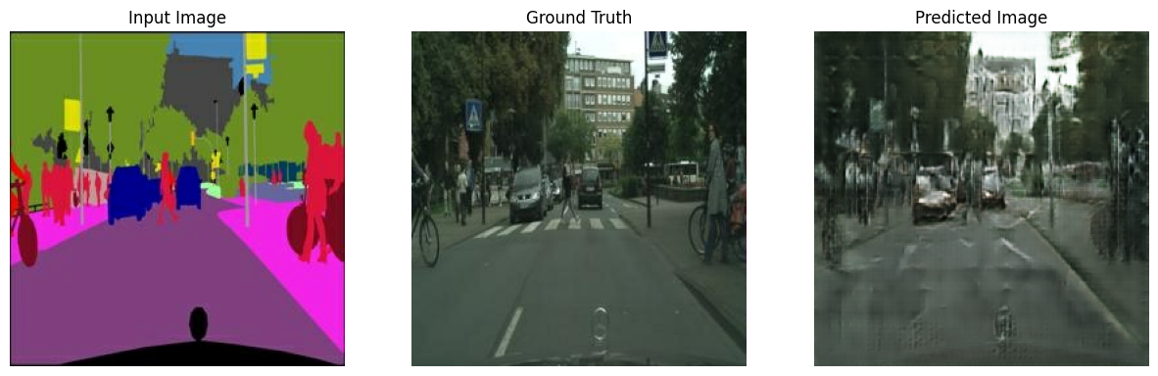
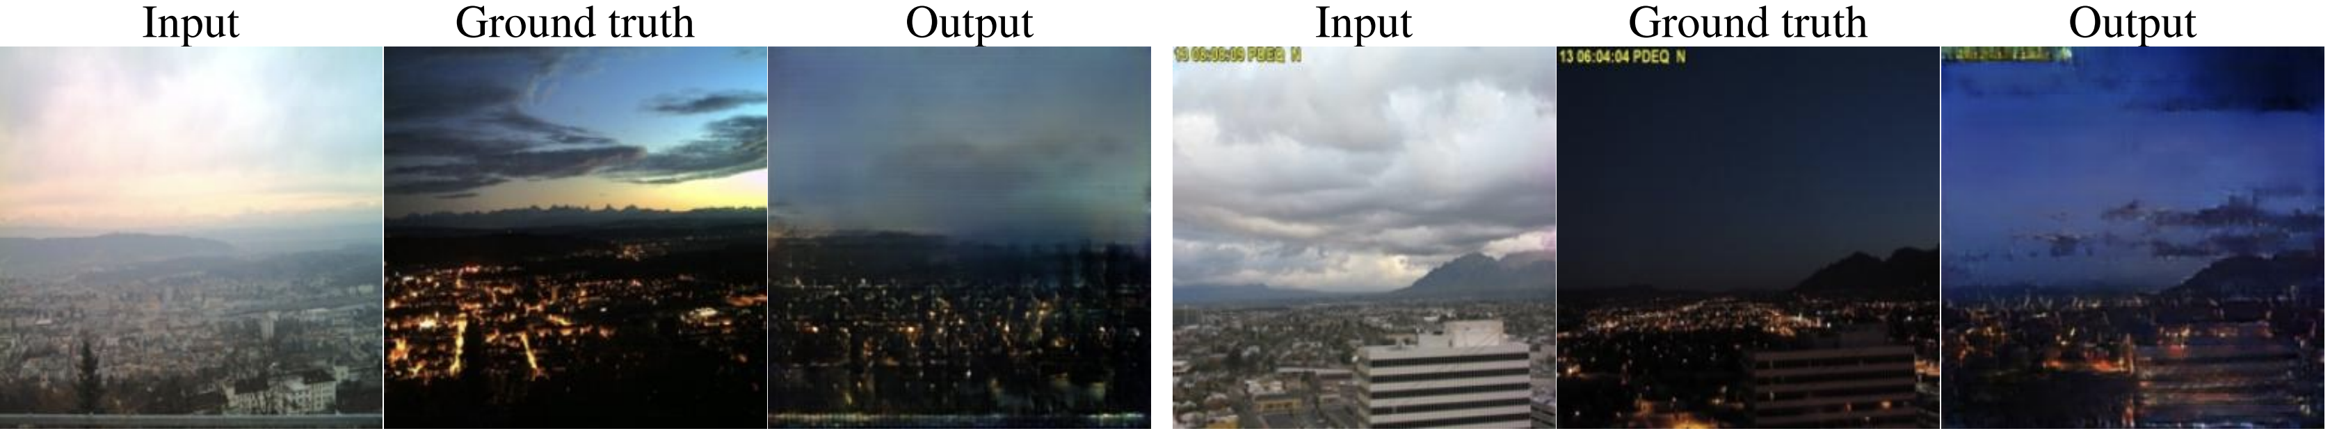
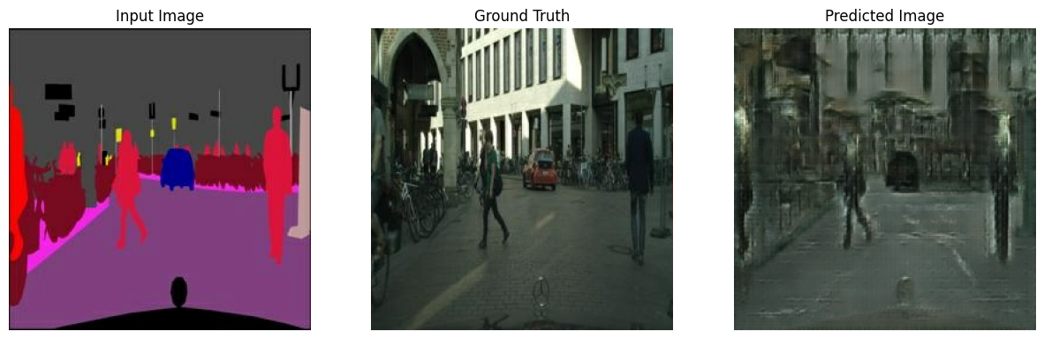
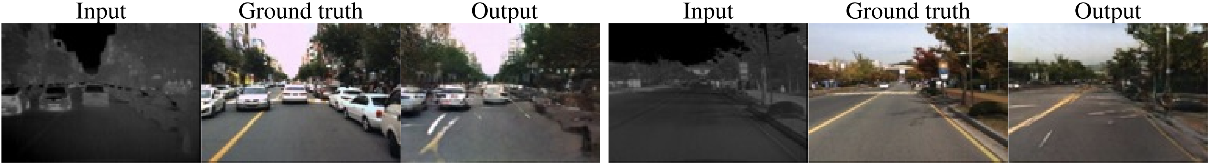
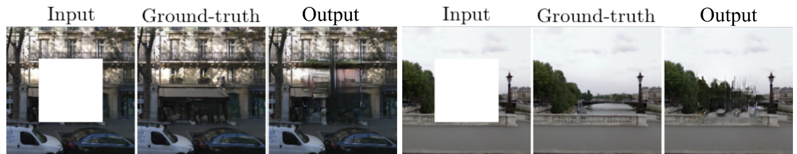
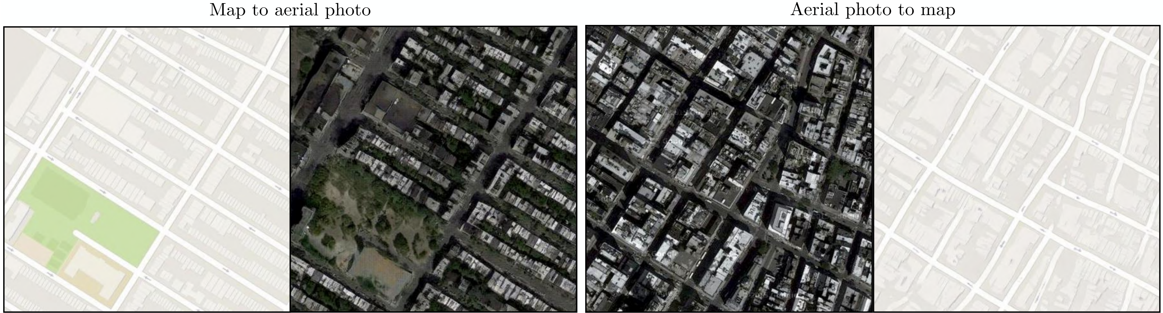
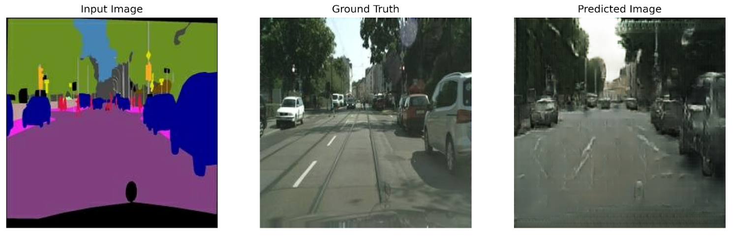
pix2pix – primeri izlaza

Slide 42
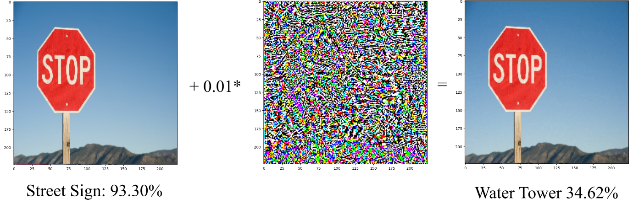

4.2. Suparničko obučavanje (Adversarial Training) 4.2.1. FGSM (Fast Gradient Signed Method)
loss_object = tf.keras.losses.CategoricalCrossentropy()
# implementcija FGSM metode
def create_adversarial_pattern(input_image, input_label):
with tf.GradientTape() as tape:
tape.watch(input_image)
prediction = pretrained_model(input_image)
loss = loss_object(input_label, prediction)
# Gradijent funkcije gubitka
gradient = tape.gradient(loss, input_image)
# Sign funkcija
signed_grad = tf.sign(gradient)
return signed_grad
Računamo znak gradijenta funkcije gubitka za dat ulaz i dat izlaz
Originalnom ulazu dodajemo ovako dobijene vrednosti (pomnožene malim faktorom
$$adv\left(x\right)=x+ε∙sign\left(∇_{x}J\left(θ , x , y\right)\right)$$
I. J. Goodfellow, J. Shlens, and C. Szegedy, “Explaining and Harnessing Adversarial Examples.” 2015.

Slide 43




4.3. Neuralni Transfer Stilova
Podrazumevaju manipulacije nad izlazima pojedinačnih slojeva CNN u cilju prenosa stila jedne slike na drugu sliku
Gradijentnim spustom se minimizuje reprezentacija stila originalne slike i slike kojom je zadat stil
Najčešće za umetničke stilova
L. A. Gatys, A. S. Ecker, and M. Bethge, “A neural algorithm of artistic style,” ArXiv Prepr. ArXiv150806576, 2015.

Slide 44





4.3. Neuralni Transfer Stilova

Slide 45



4.4. Stable Diffusion
Poslednjih godina postaju popularni modeli poput Stable Diffusion, DALL-E, Midjourney…
Bazira se na principu super-rezolucije, pri čemu se denoising obavlja nad šumom više puta (model se pušta da „halucinira“)
R. Rombach, A. Blattmann, D. Lorenz, P. Esser, and B. Ommer, “High-resolution image synthesis with latent diffusion models,” in Proceedings of the IEEE/CVF conference on computer vision and pattern recognition, 2022, pp. 10684–10695.
model = keras_cv.models.StableDiffusion(
img_width=512, img_height=320, jit_compile=False
)
images = model.text_to_image("photograph of an empty“
„road in nature", batch_size=3)

Slide 46




4.4. Stable Diffusion
from diffusers import StableDiffusionImg2ImgPipeline
init_image = Image.open('./street.png').convert("RGB")
init_image = init_image.resize((768, 512))
model_id_or_path = "runwayml/stable-diffusion-v1-5"
pipe = StableDiffusionImg2ImgPipeline.from_pretrained(
model_id_or_path, torch_dtype=torch.float16)
pipe = pipe.to("cuda")
prompt = "a photograph of a city street, sharp focus, realistic"
images = pipe(prompt=prompt, image=init_image,
strength=0.75, guidance_scale=4.5).images
Ukoliko se u koraku difuzije ne polazi od nasumičnog šuma već od neke slike, SD se može koristiti i kao tehnika za image-to-image translaciju, slično pix2pix modelu

Slide 47
5. Zaključak
Augmentacija podataka je važan korak u preprocesiranju
Može dovesti do poboljšanja
Treba poznavati različite tehnike i izabrati one koje su smislene za dati domen problema
Posebno je važno da modeli u autonomnoj vožnji rade dobro u različitim situacijama

Slide 48
HVALA NA PAŽNJI

